Slide 1

Diversity in the Workplace

Slide 2
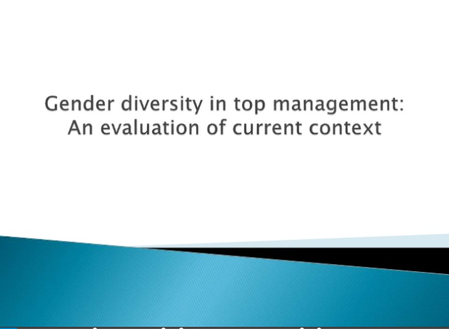

Slide 3
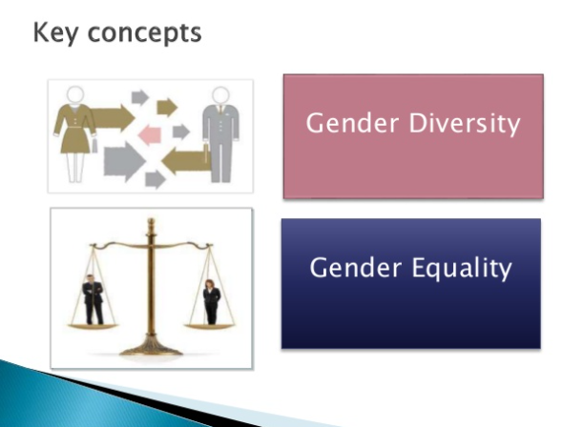

Slide 4
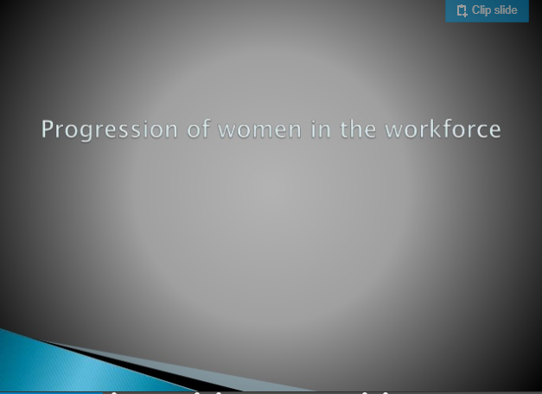

Slide 5
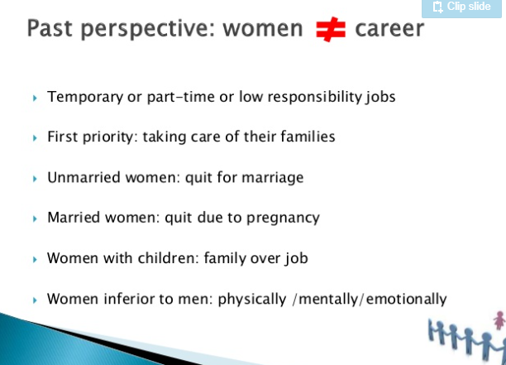

Slide 6
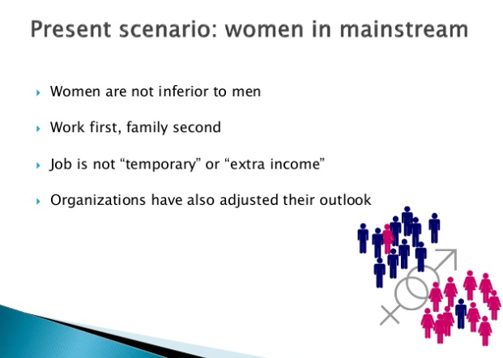

Slide 7
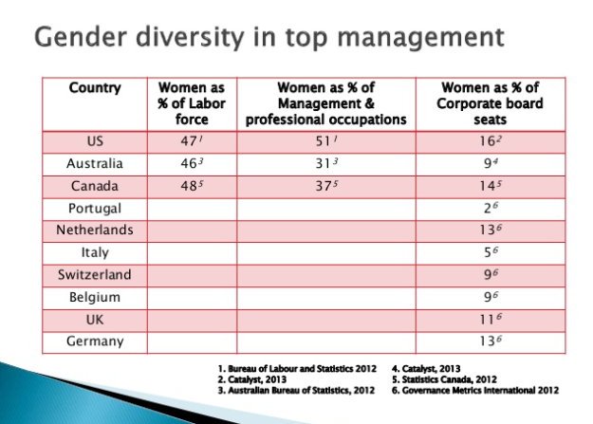

Slide 8
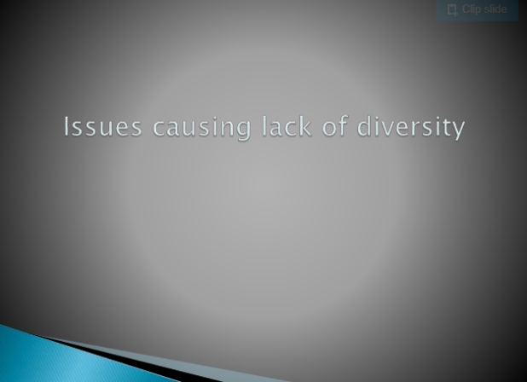

Slide 9
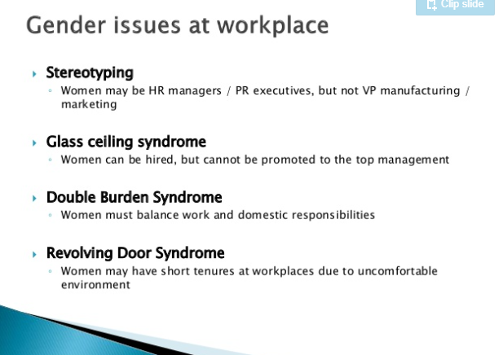

Slide 10
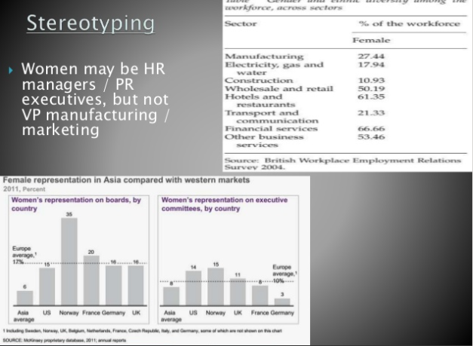

Slide 11
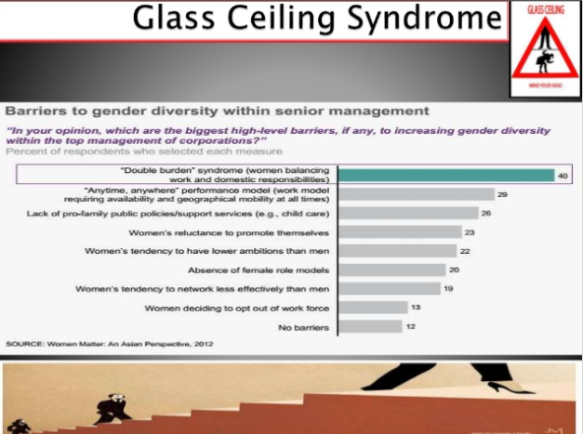

Slide 12
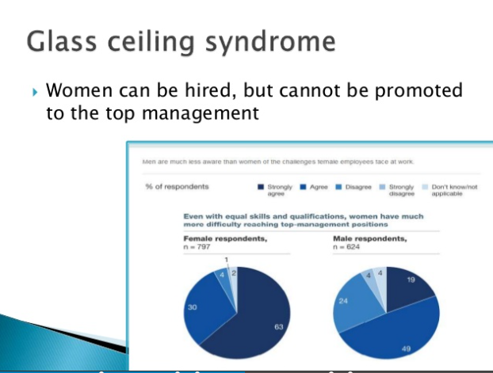

Slide 13
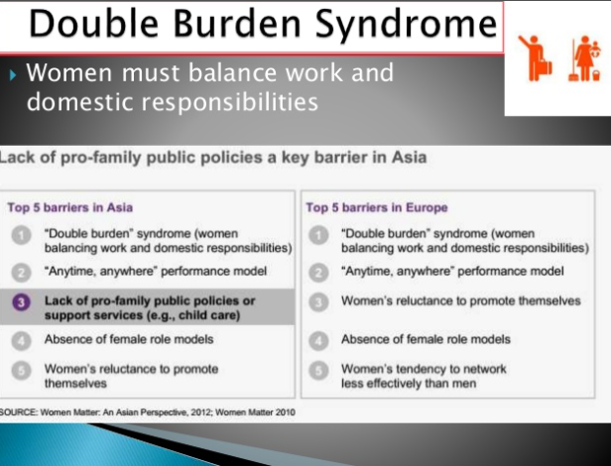

Slide 14
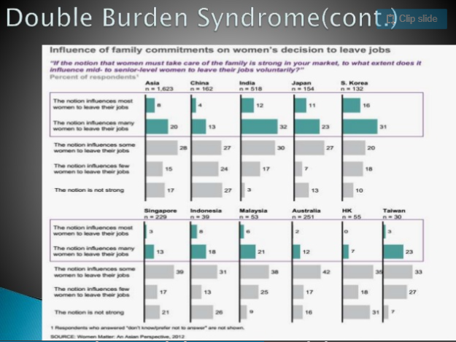

Slide 15
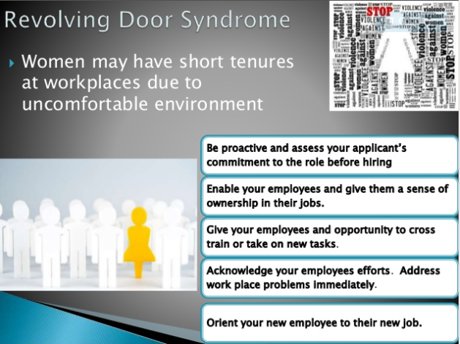

Slide 16
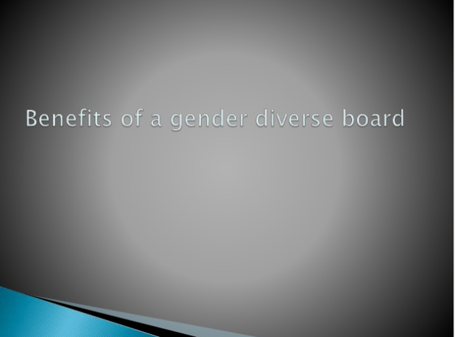

Slide 17
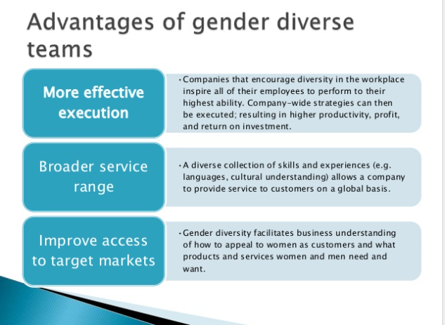

Slide 18
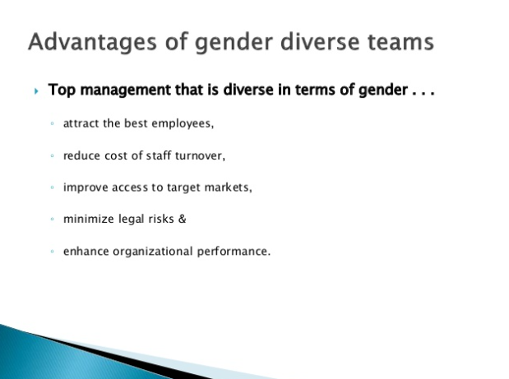

Slide 19
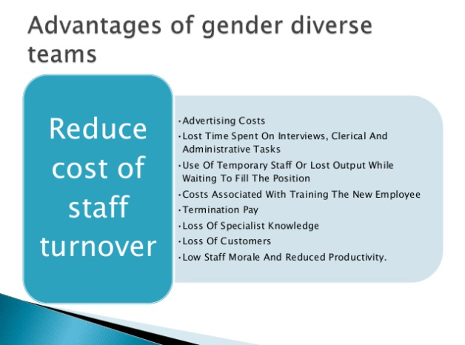

Slide 20
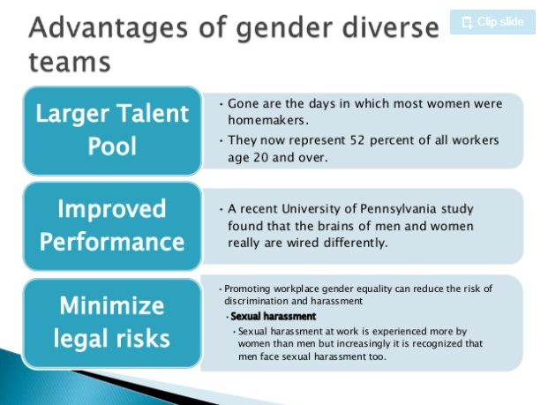

Slide 21


Slide 22
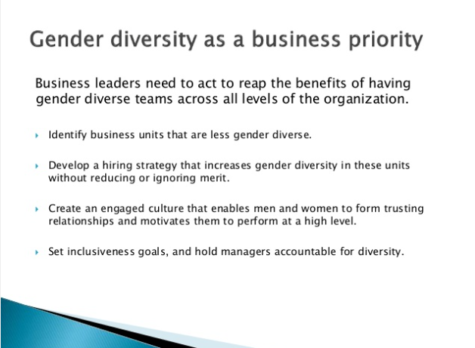

Slide 23
Cultural Diversity in the Workplace
Travel and Tourism Management

Slide 24
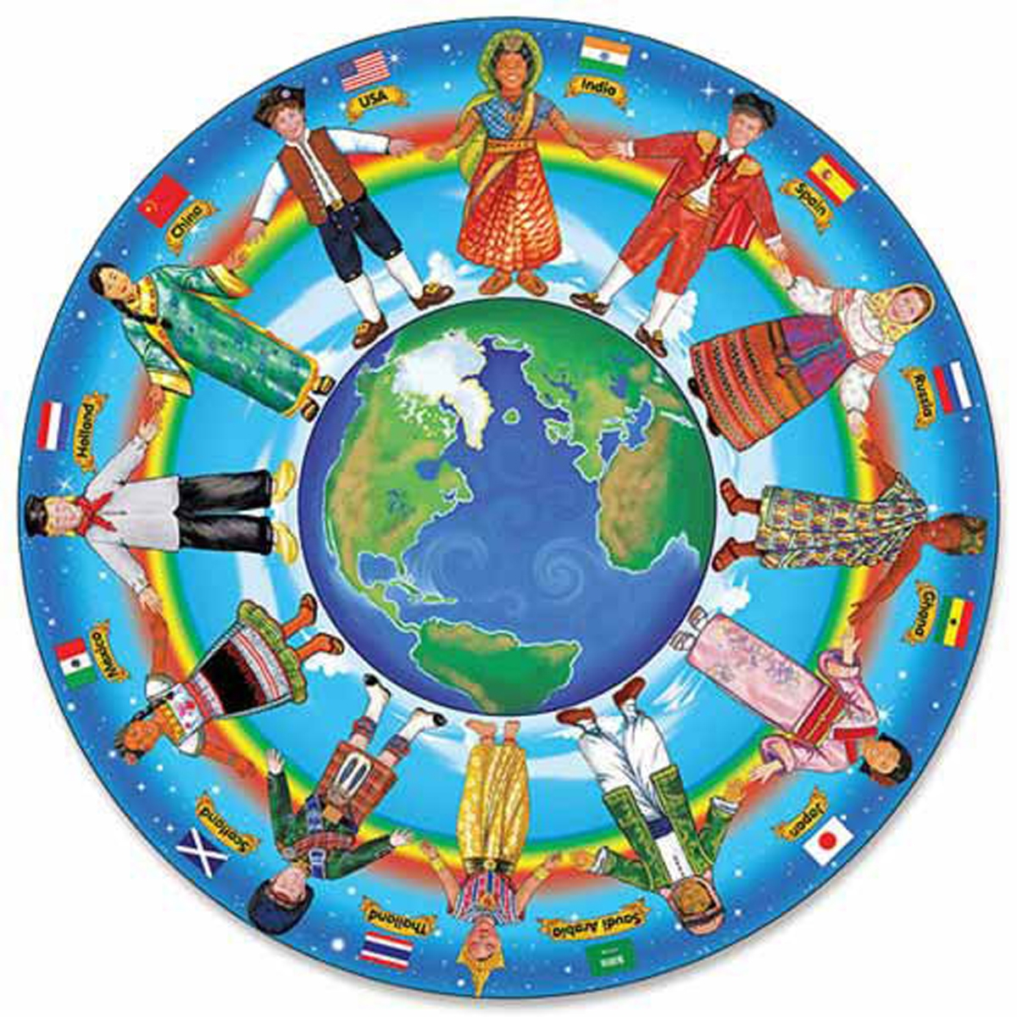
Culture
Copyright © Texas Education Agency, 2015. All rights reserved.
Notes:
Culture is the behaviors, beliefs, opinions and feelings of a particular social, ethnic or age group.
What is your cultural background?

Slide 25
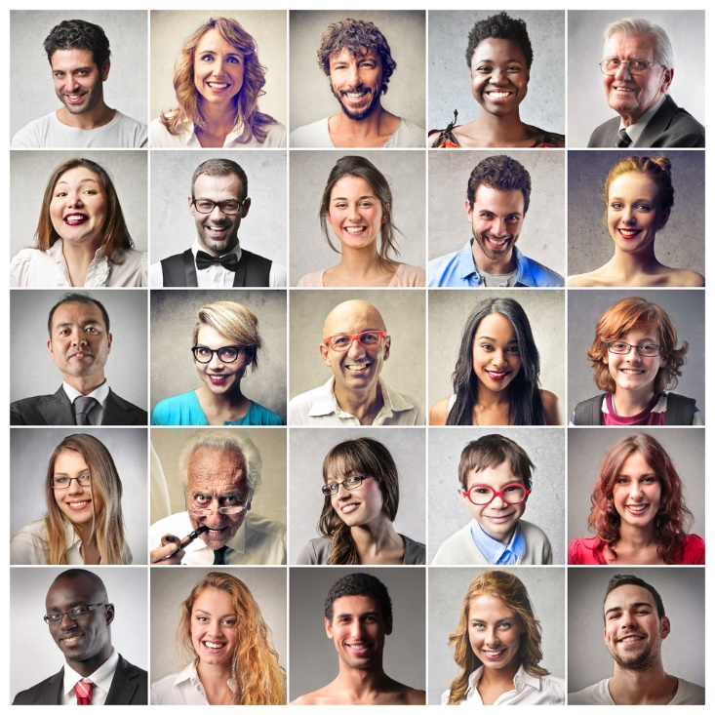
Travelers
Ages
Culture
Disabilities
Religion
Special help
Copyright © Texas Education Agency, 2015. All rights reserved.
Notes:
People who travel come from all over the world.
They represent all ages, cultures and religions.
Many may have disabilities or require special help.

Slide 26

Employees
Come from different countries with varied:
Abilities
Interests
Languages
Levels of education
Religions
Copyright © Texas Education Agency, 2015. All rights reserved.
Notes:
Employees in the travel and tourism industry come from many different countries and vary in abilities, interests, languages, education and religions.
They also vary in age from young people to older adults.

Slide 27

Workplace
Working together as a team includes:
Ability to work with others
Commitment to the team
Cooperation
Copyright © Texas Education Agency, 2015. All rights reserved.
Notes:
To be successful on the job, teamwork is essential.
The ability to work with others includes being pleasant, understanding and respectful.
Commitment to the team means that you will fulfill your obligations and do your part of the work.
Cooperating with other workers to get the job is vital in the travel and tourism industry.
Being to get along with everyone will make the job easier.

